Slide 1


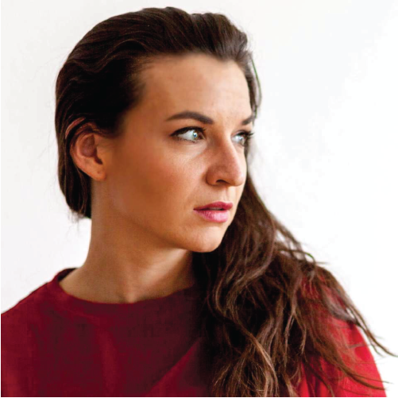


Slide 2
p(D|h₂)p₀(h₂)
p(D|h₁)p₀(h₁)
p(D|h₃)p₀(h₃)
p(h₁) vs p(h₂)
vs p(h₃)
p(h₁) vs p(h₂)
vs p(h₃)
p(h₁) vs p(h₂) vs p(h₃)
p₀(h₂)
p₀(h₁)
p₀(h₃)
maximize negative free energy
p(h₂)
Notes:
You’ve started with a few hypotheses
As I’ve continued to show you pictures, you’ve acquired information on what this image could be.

Slide 3
Bounded rationality in Perception
A practical session on impracticality

Slide 4
The real-world decision maker
Limited resources for optimization
Model uncertainty

Slide 5
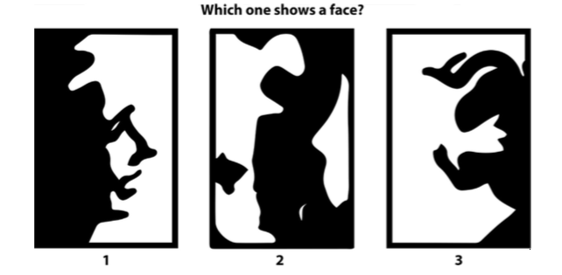
The real-world perceiver
jumps to conclusions
is susceptible to illusory pattern perception
overfits/exhibits irrational primacy

Slide 6
Bounded rational decision-making
Free energy functional, bounded rational decision making:
Approximate posterior
-ΔF
Utility
function
Prior
Bound
Bounded rational perception
Free energy, bounded rational inference:
Approximate posterior
Log likelihood
Prior
Notes:
It could be that an OCD patient has a normal prior, but has a time evolving alpha, so their free energy decreases after making a check
Reformat? Talk about the bound in limits

Slide 7
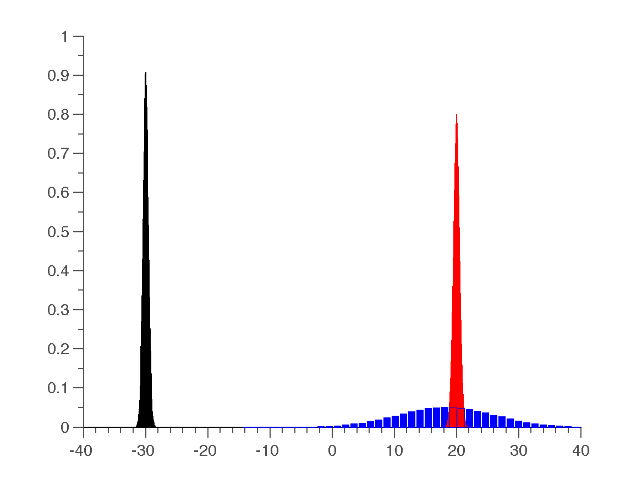
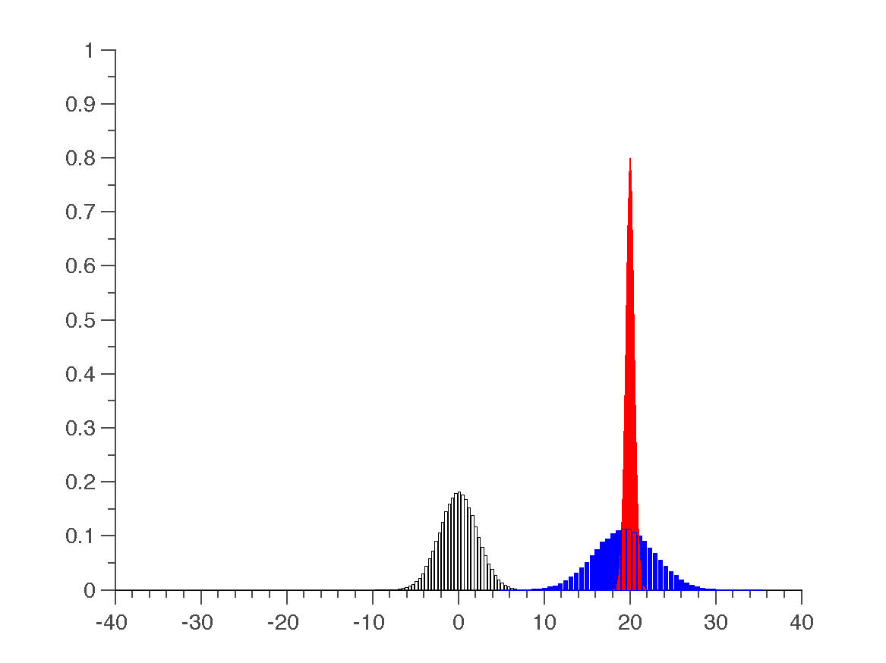
Vanilla Bayesian inference
Currently, Bayesian inference relies on the prior to capture impractical or irregular perception.
Malformed prior (incorrect mean, high precision) Appropriate prior (reasonable mean, variance)
Prior
Underlying density
Underlying density
Variational
approximation
Prior
Variational
approximation
Notes:
It’s important to note here that these might not be differentiable. Also important to note that information would havet o be limited here.

Slide 8
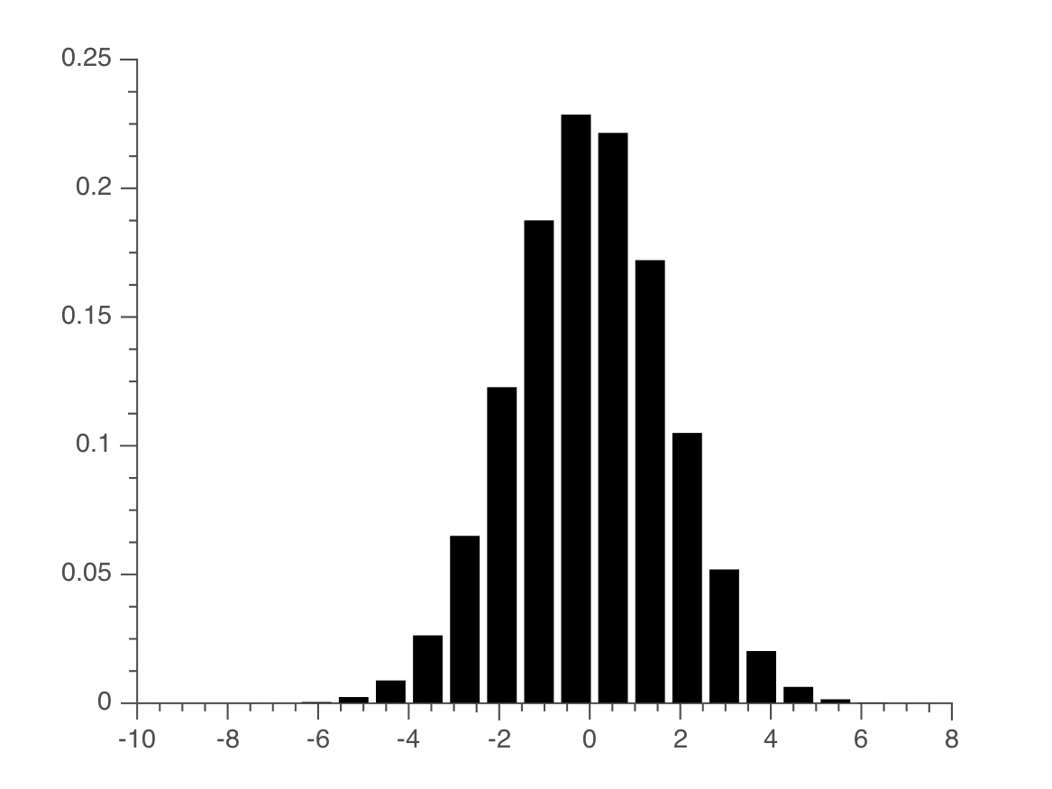
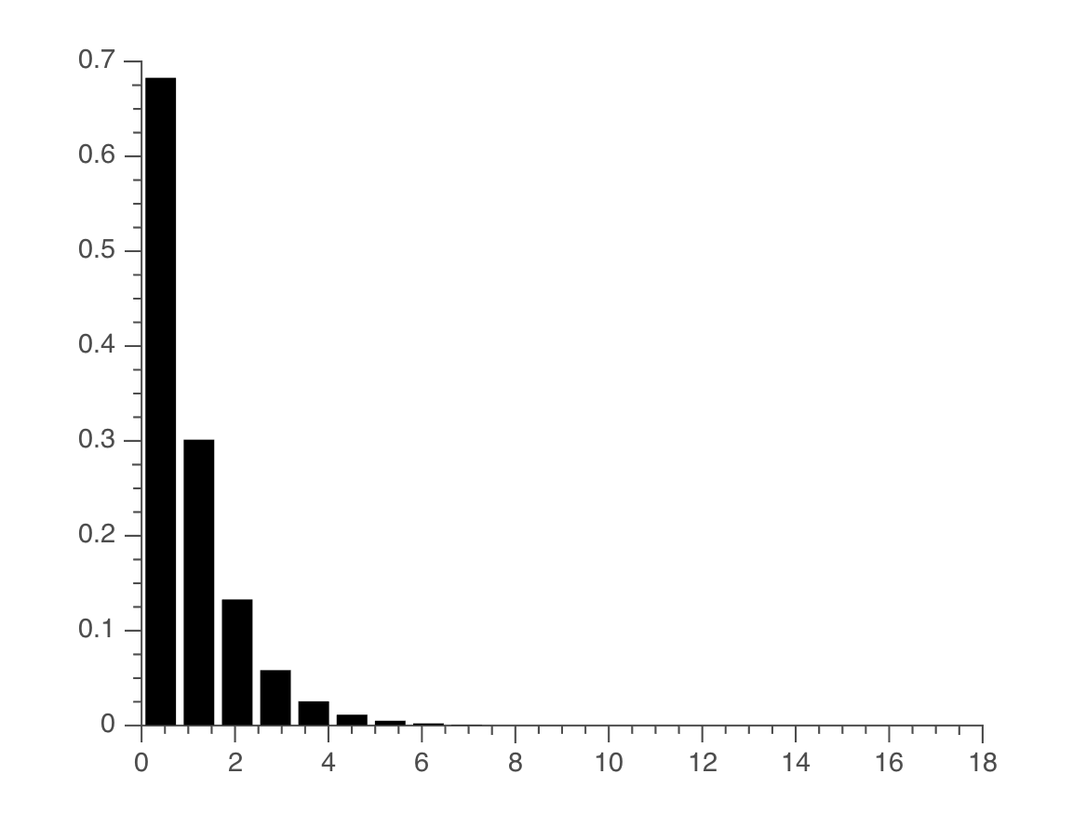
Two dials on perception
priors
Index of rationality
Notes:
I should take a moment here and say that these two things are not entirely different. Alpha is a kind of dial on the prior variance, as many of you might already see. But cognitively, they have very different interpretations. With somethhign like pathological in a group of people with very similar prior experiences, one might exhibit this behavior.

Slide 9
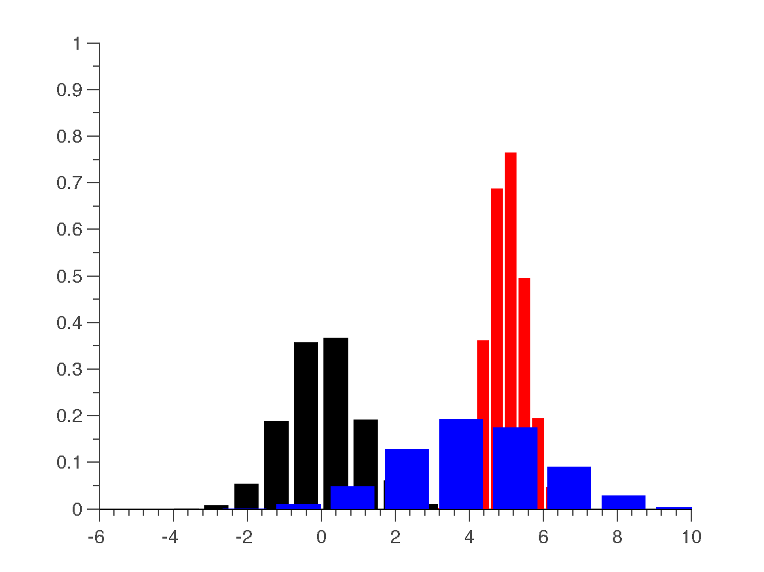
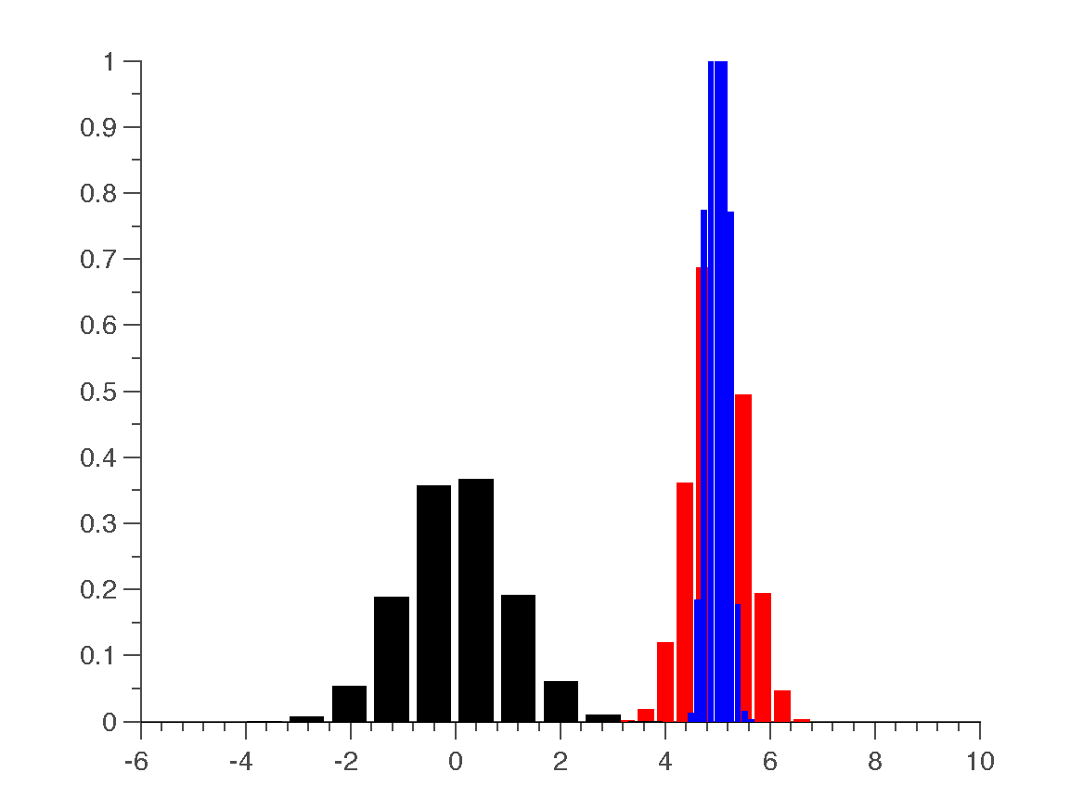
Bounded rationality in perception
α could also serve as a dial on rationality, where we assume that the subject has reasonable priors, but his or her ability to maximize likelihood is variably limited by constraint.
Low α—subject is clobbered by constraint High α—subject overfits
Variational
approximation
Underlying density
Prior
Variational
approximation
Prior
Underlying density
Notes:
Given a limited amount of data, you see the emergence of these two subjects
Sbuject 1 is clobbered by constriaint
Subject 2 overfits
Representative subjects for pathology

Slide 10
Beliefs about information
Based on the actual amount of information given to or available to the actor, how do they perceive their environment?
Toy example (from before) : Two subjects are shown 10 samples from a distribution with mean 5 and variance 0.5 (red) (total information content: 0.8 bits). Both subjects begin with the same prior (shown in black) with mean 0 and variance 1 (information content: 1.8 bits).
Subject 1
Low α – large constraint
Subject 2
High α – low constraint
Variational
approximation
Information acquired:
ΔH = change in entropy between posterior and prior
Underlying density
Prior
Prior
Variational
approximation
Underlying density
ΔH = -1.1 bits
ΔH = 2.5 bits
Notes:
Information prop to entropy
Both subejcts begin with the same information, but one subject feels like they’ve lost information with each sample, one subject believes he’s acquired too much information.

Slide 11
Why is this important?
Depression
Low α – large constraint
Pathological Gambler
High α – low constraint
likelihood
Traits
q
Traits
Random action
Helplessness
Anhedonia
Risk seeking
Impulsivity
Illusory pattern perception
prior
prior
q
likelihood
Why do I like it?
Models borrowed from physics bring with them a wealth of intuition that help structure and bound the dauntingly nebulous problem of cognition.

Slide 12
The nitty gritty

Slide 13
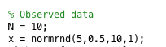
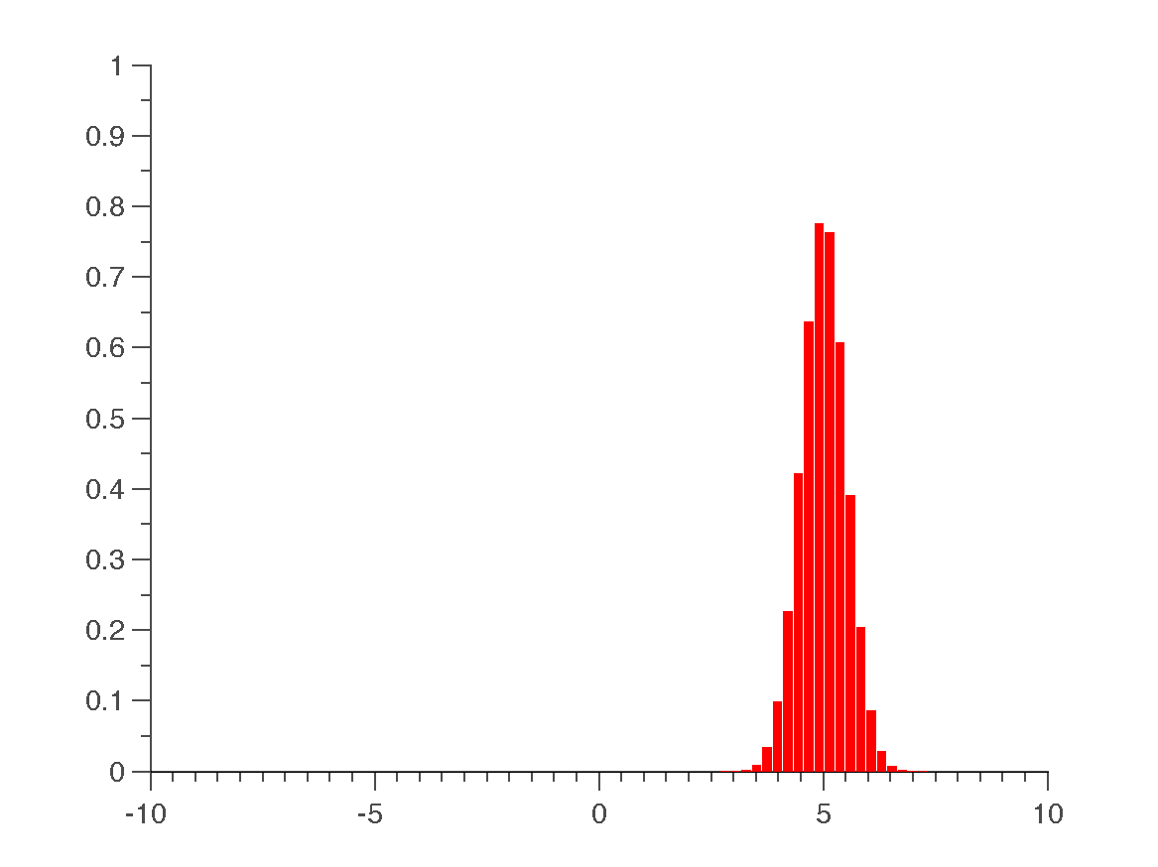
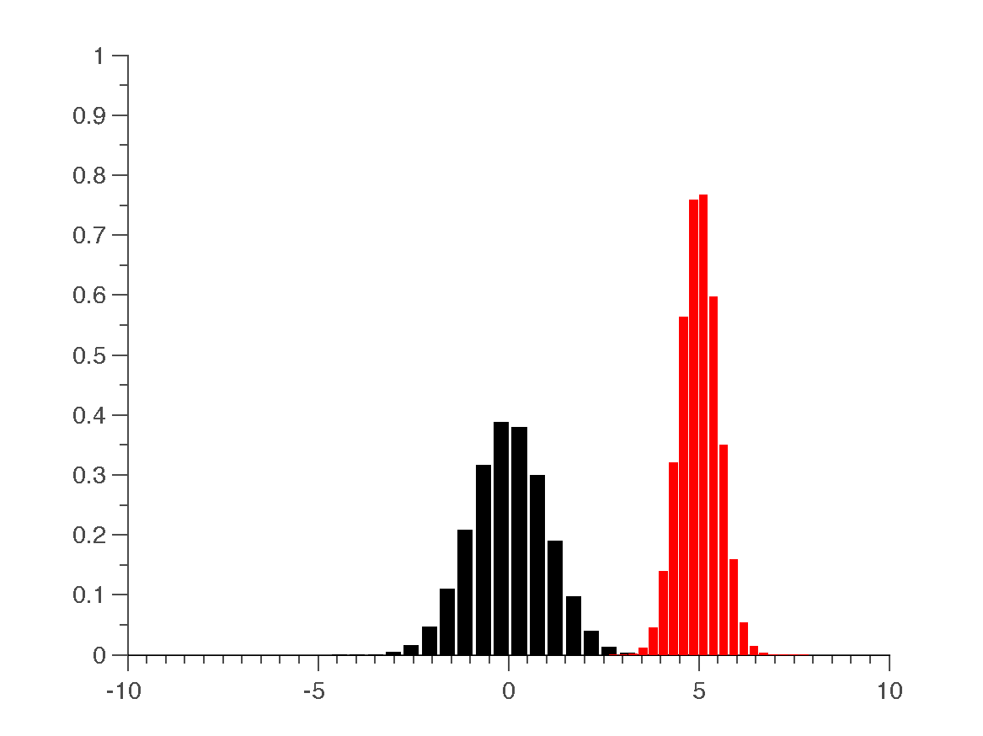
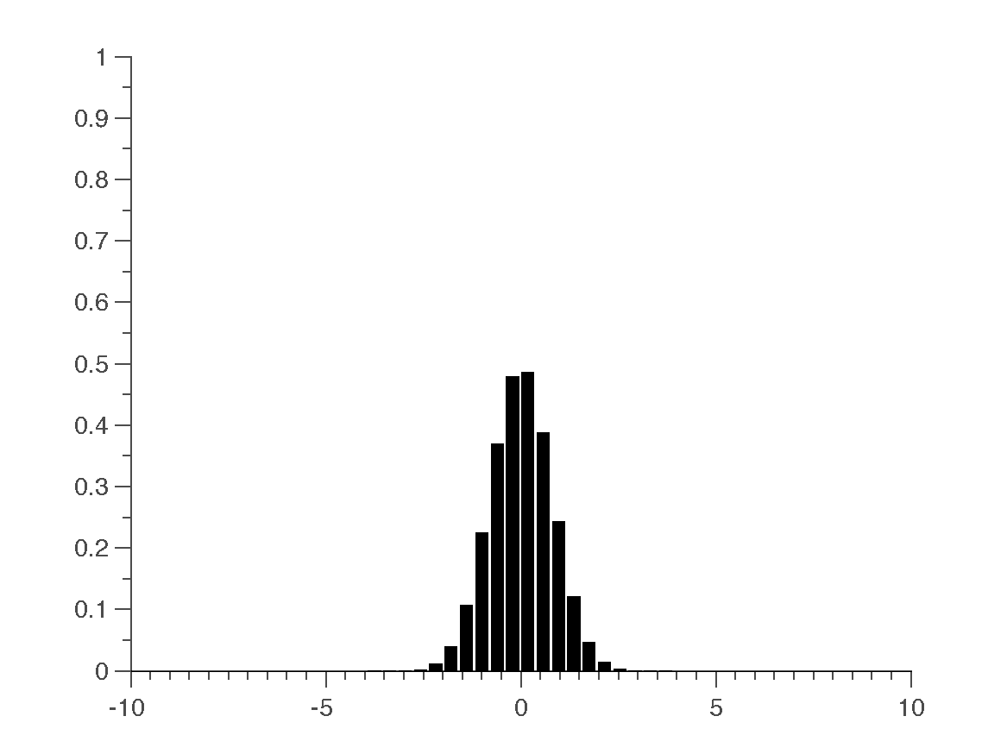
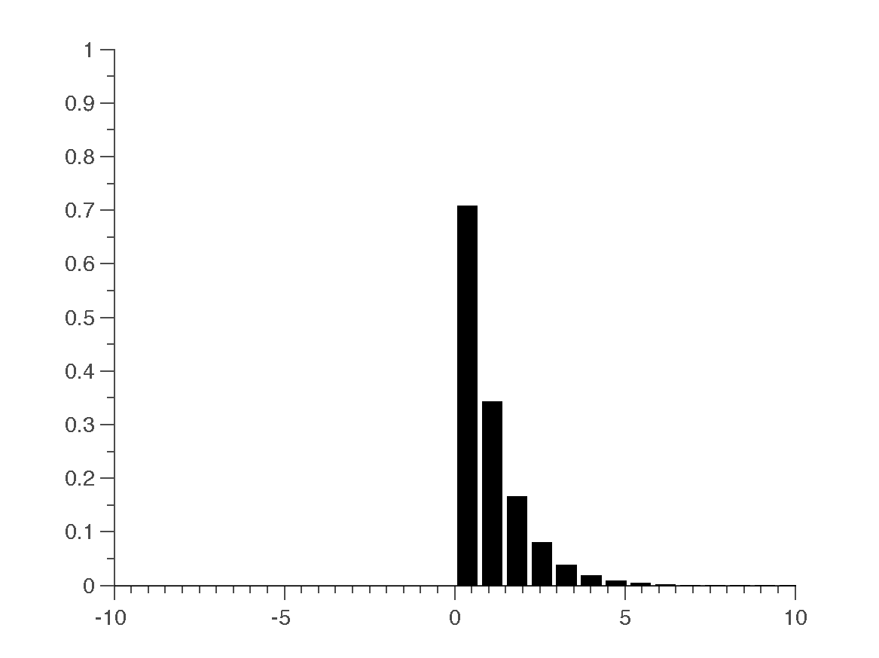
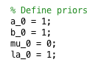
Code your own adventure
cpc_free_energy.m
Simple I-D Gaussian toy model.
Step 1: Choose a likelihood. Make your life easy and choose a Gaussian
Step 2: Pick your priors over the sufficient statistics.
p(D|μ, τ) ~ N(μ,τ)
Prior and likelihood
p(μ) ~ N(μ₀,λ₀τ)
p(τ) ~ Γ(a₀,b₀)

Slide 14
Simple toy model
a₀
free_energy.m
Define a simple model with a Gaussian likelihood:
τ
b₀
D = data
μ = mean of Gaussian
τ = precision of Gaussian (1/σ²)
D
μ
The corresponding priors are:
μ₀
N
τ₀

Slide 15
Free energy functional
free_energy.m
As we saw before, the free energy functional is composed of the expectation of the log likelihood under the approximate posterior
Term 1
Term 2
Term 3
Term 4
Term 5

Slide 16
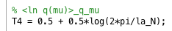
Free energy terms
free_energy.m
Term 1
Expectation of log likelihood under approximate posterior
Term 2
Entropy of approximate posterior over the mean.

Slide 17
Free energy terms continued
free_energy.m
Term 3
Entropy of approximate posterior over the precision.
Term 4
Expectation of prior on the mean over approximate posterior.

Slide 18
Free energy terms
free_energy.m
Term 5
Expectation of prior on precision over approximate posterior.

Slide 19
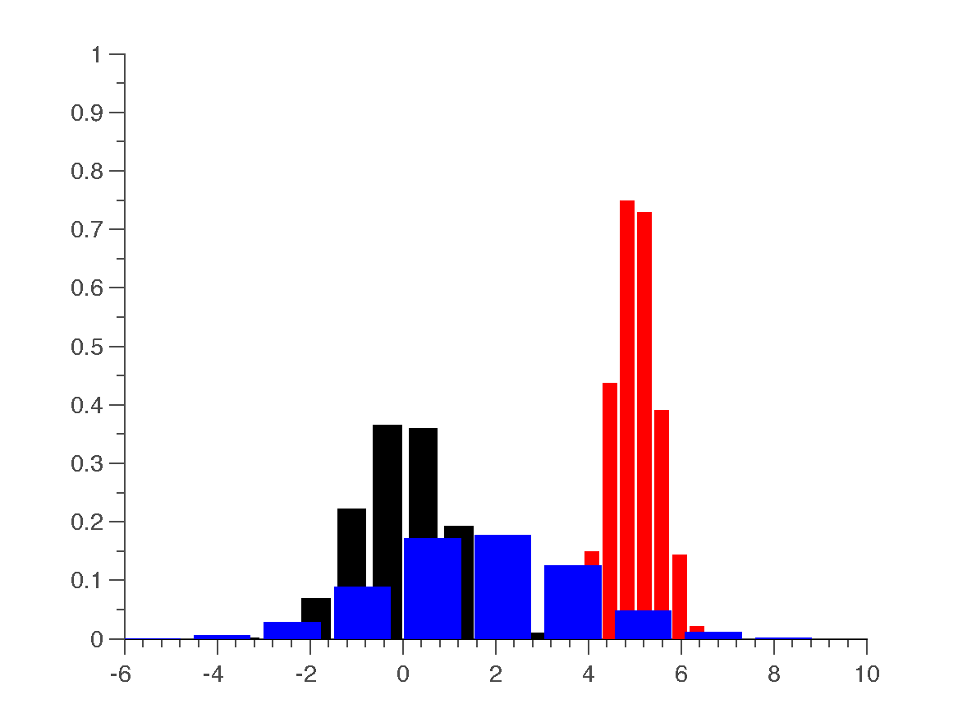
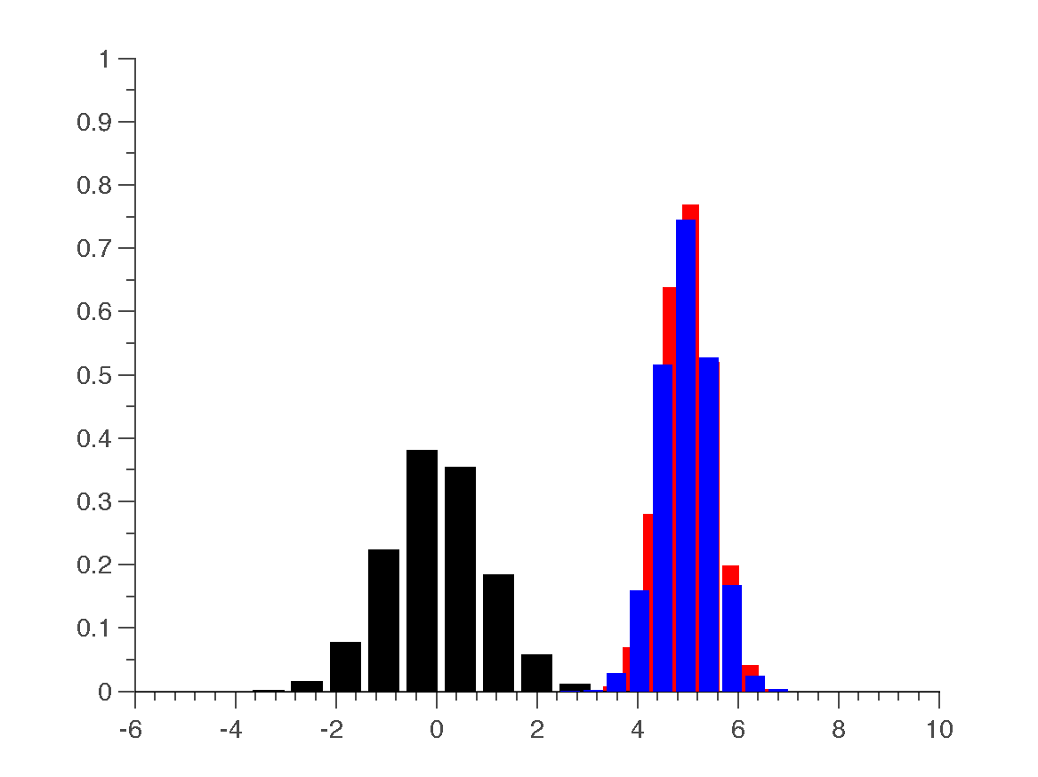
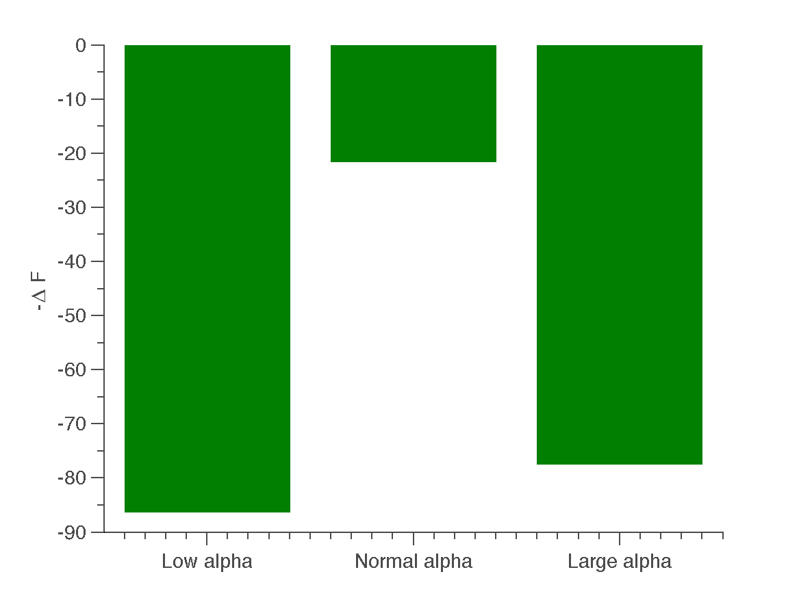
Output figures:
cpc_free_energy.m
Low α
Normal α
High α
-ΔF

Slide 20

Questions? Links:
Link to code: https://github.com/saeepaliwal/CPC_FreeEnergy.git
Email me with questions/interest: paliwal@biomed.ee.ethz.ch
Questions?
Notes:
It’s important to note here that these might not be differentiable

Slide 21
Thank you!

